Slide 1
Lecture 18: Minimum Spanning Tree
Keren Zhu
kerenzhu@cse.cuhk.edu.hk

Slide 2
Outline
MST problem
Problem formulation
Applications
Prim’s Algorithm
Kruskal’s algorithm

Slide 3
Spanning trees
Given a connected graph with |V| = n vertices, a spanning tree is defined a collection of n – 1 edges which connect all n vertices
The n vertices and n – 1 edges define a connected sub-graph
A spanning tree is not necessarily unique

Slide 4
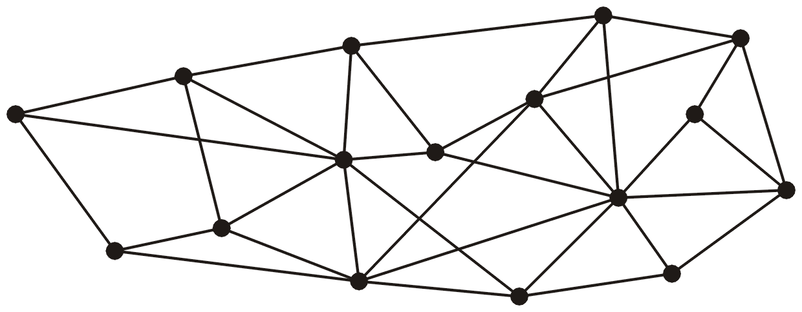
Spanning trees
This graph has 16 vertices and 35 edges

Slide 5
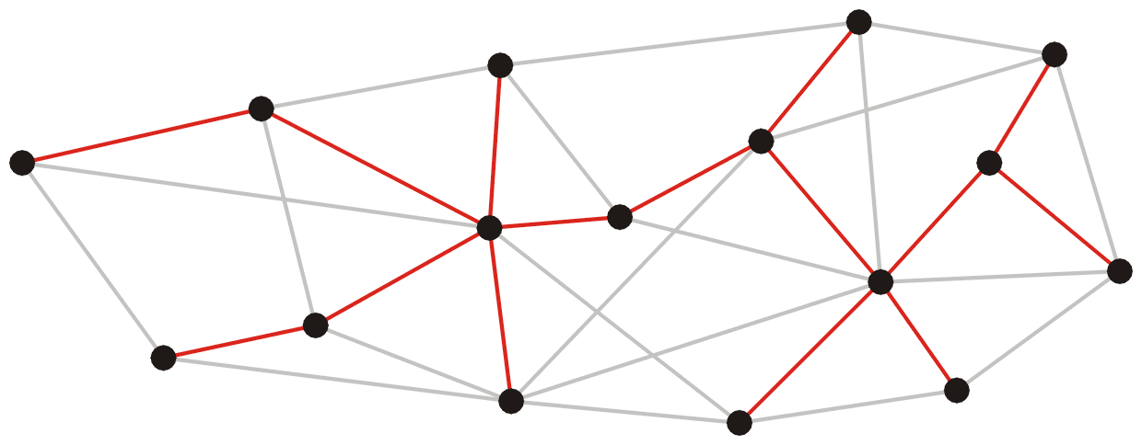
Spanning trees
These 15 edges form a minimum spanning tree

Slide 6
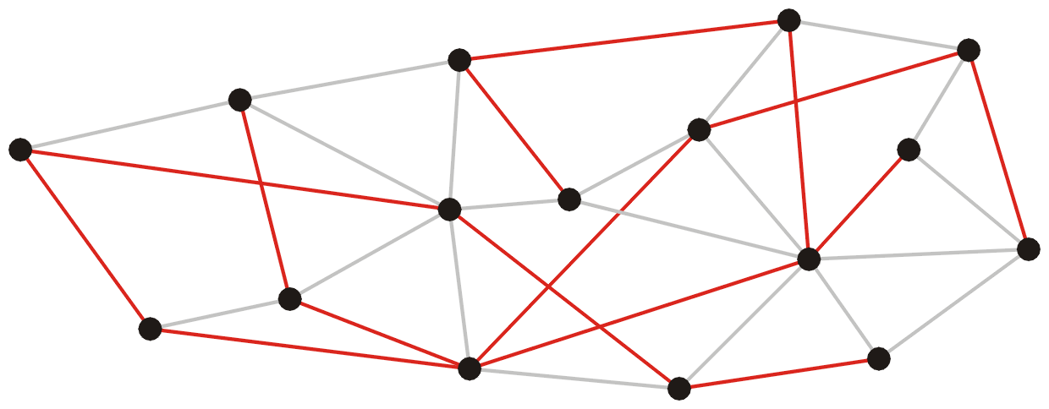
Spanning trees
As do these 15 edges:

Slide 7
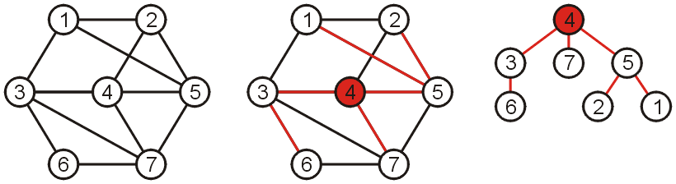
Spanning trees
Such a collection of edges is called a tree because if any vertex is taken to be the root, we form a tree by treating the adjacent vertices as children, and so on...

Slide 8

Spanning trees on weighted graphs
The weight of a spanning tree is the sum of the weights on all the edges which comprise the spanning tree
The weight of this spanning tree is 20

Slide 9
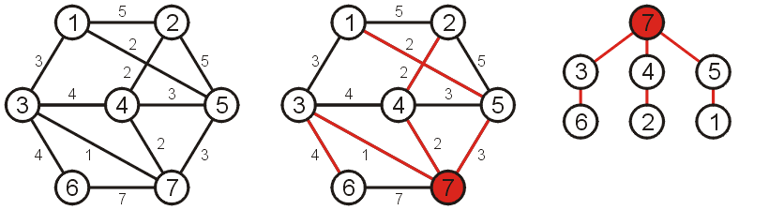
Minimum Spanning Trees
Which spanning tree which minimizes the weight?
Such a tree is termed a minimum spanning tree
The weight of this spanning tree is 14

Slide 10
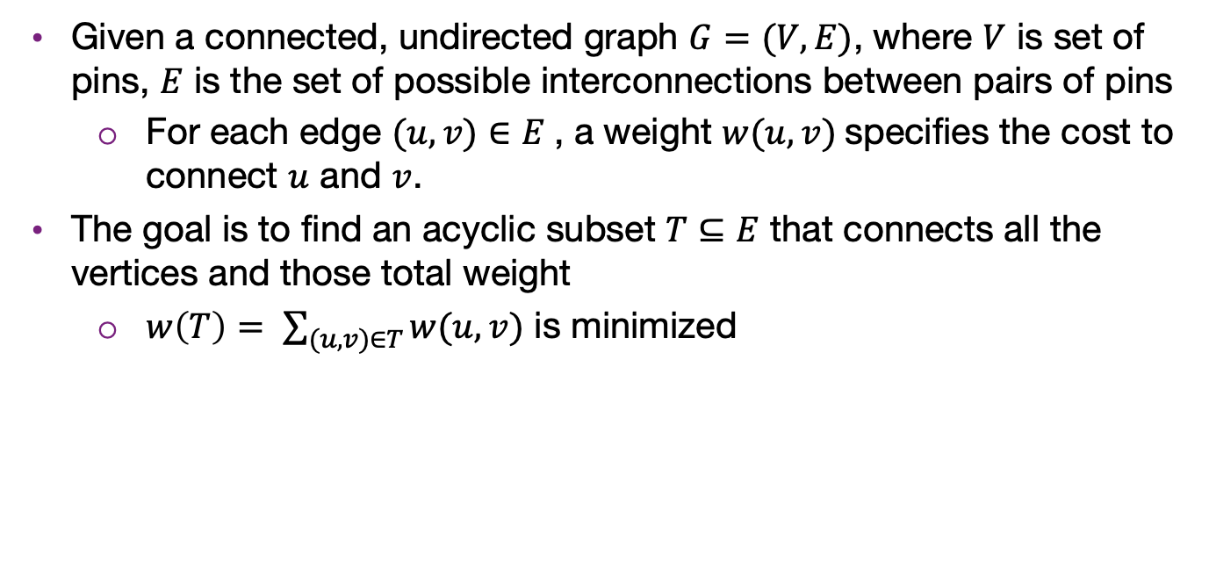
Formal formulation of MST problem
Given a connected, undirected graph $G=(V,E)$, where $V$ is set of pins, $E$ is the set of possible interconnections between pairs of pins
For each edge $(u, v)∈E$, a weight $w(u, v)$specifies the cost to connect $u$ and $v$.
The goal is to find an acyclic subset $T⊆E$ that connects all the vertices and those total weight
$w\left(T\right)= \sum_{(u,v)∈T}{w(u, v)}$ is minimized

Slide 11
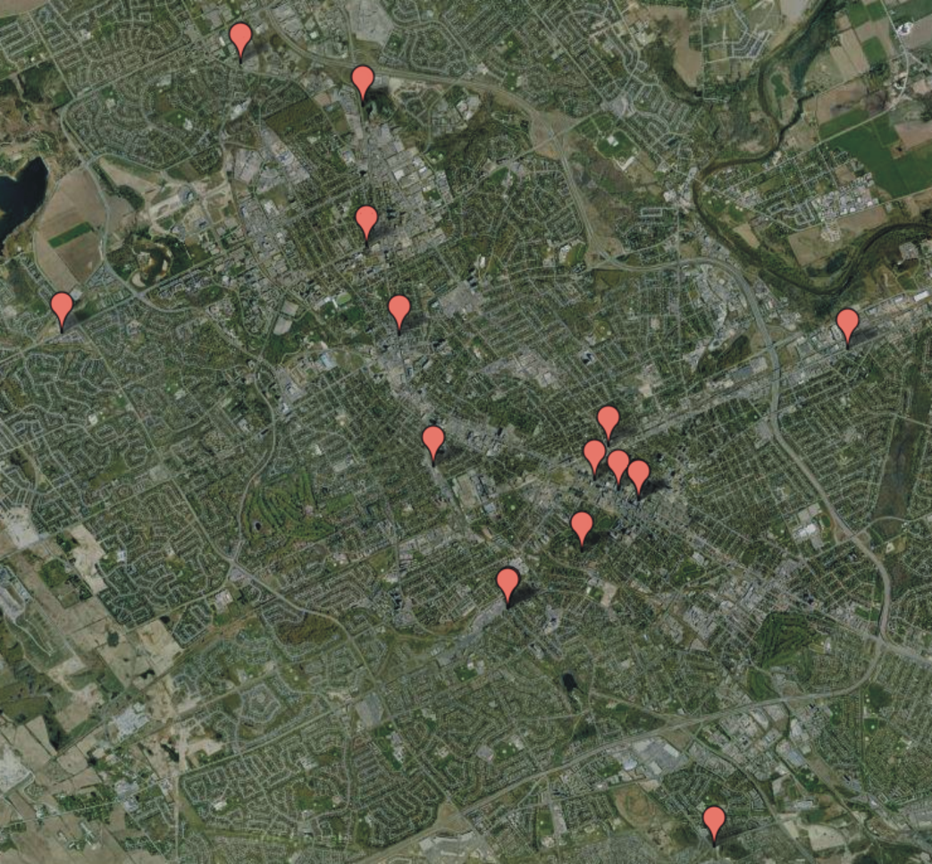
Application
Consider attempting to find the best means of connecting a number of locations
Minimize the number of bridges
Costs not strictly dependant on distances

Slide 12
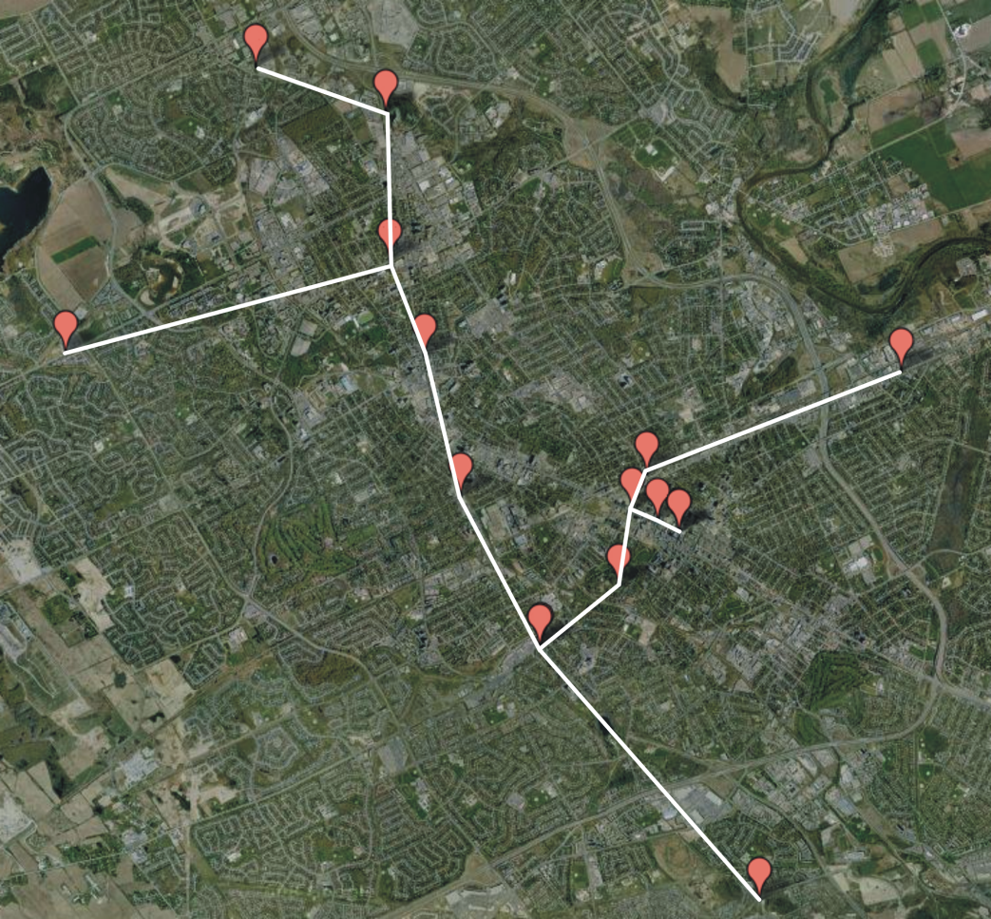
Application
A minimum spanning tree will provide the optimal solution

Slide 13
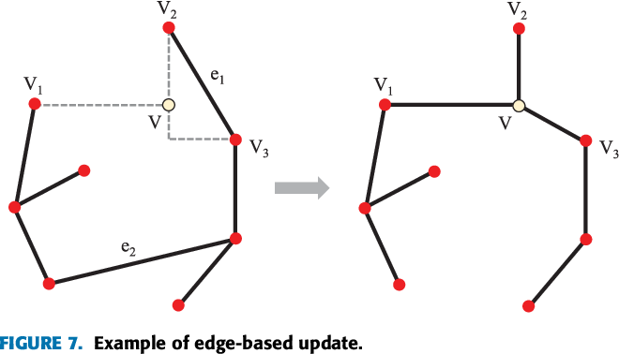
Application
Circuit and chip interconnection is also a typical application

Slide 14
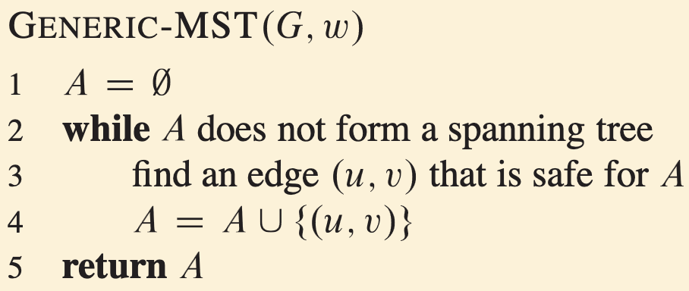
Greedy approach for solving MST
A greedy algorithm is any algorithm that follows the problem-solving heuristic of making the locally optimal choice at each stage. – Wikipedia
Fortunately, MST can be solved with greedy algorithm
Iteratively select a local optimal safe edge into the tree
Will result in global optimality

Slide 15
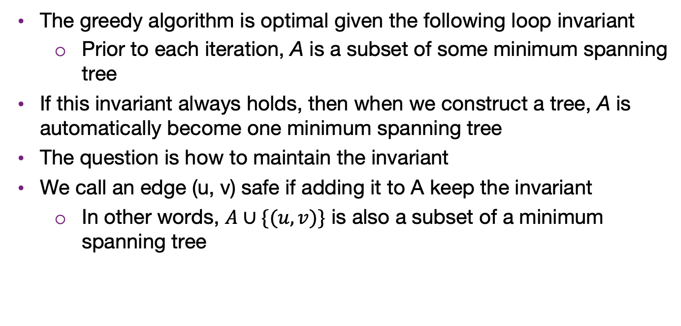
Generic-MST
The greedy algorithm is optimal given the following loop invariant
Prior to each iteration, A is a subset of some minimum spanning tree
If this invariant always holds, then when we construct a tree, A is automatically become one minimum spanning tree
The question is how to maintain the invariant
We call an edge (u, v) safe if adding it to A keep the invariant
In other words, $A∪\{(u,v)\}$ is also a subset of a minimum spanning tree

Slide 16
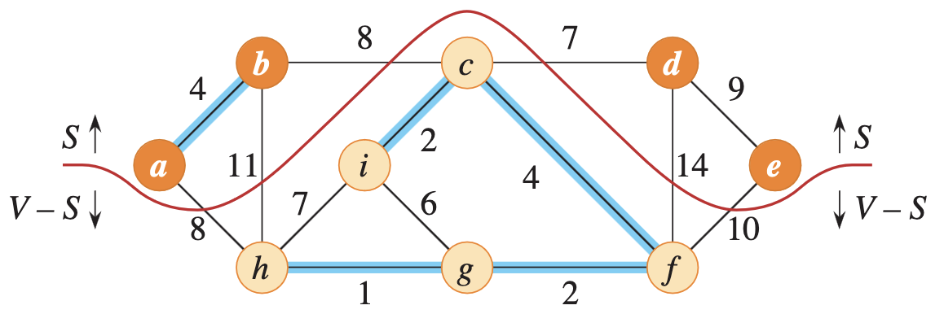
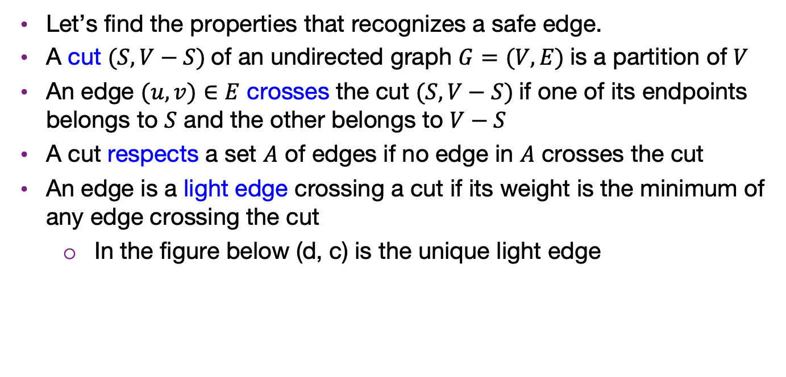
What edges are safe?
Let’s find the properties that recognizes a safe edge.
A cut $(S, V−S)$of an undirected graph $G=(V,E)$is a partition of $V$
An edge $(u,v)∈E$ crosses the cut $(S, V−S)$if one of its endpoints belongs to $S$ and the other belongs to $V−S$
A cut respects a set $A$ of edges if no edge in $A$ crosses the cut
An edge is a light edge crossing a cut if its weight is the minimum of any edge crossing the cut
In the figure below (d, c) is the unique light edge

Slide 17
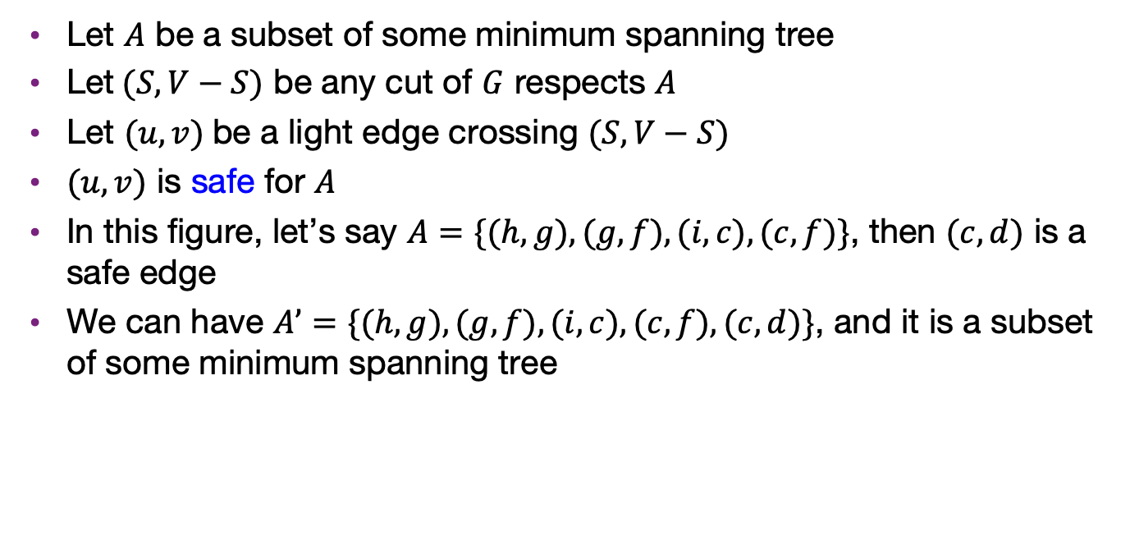
What edges are safe?
Let $A$ be a subset of some minimum spanning tree
Let$(S, V−S)$ be any cut of $G$ respects $A$
Let $(u, v)$be a light edge crossing $(S, V−S)$
$(u,v)$ is safe for $A$
In this figure, let’s say $A=\{(h, g), (g, f), (i, c), (c,f)\}$, then $(c, d)$ is a safe edge
We can have $A’=\{(h, g), (g, f), (i, c), (c,f), (c, d)\}$, and it is a subset of some minimum spanning tree

Slide 18
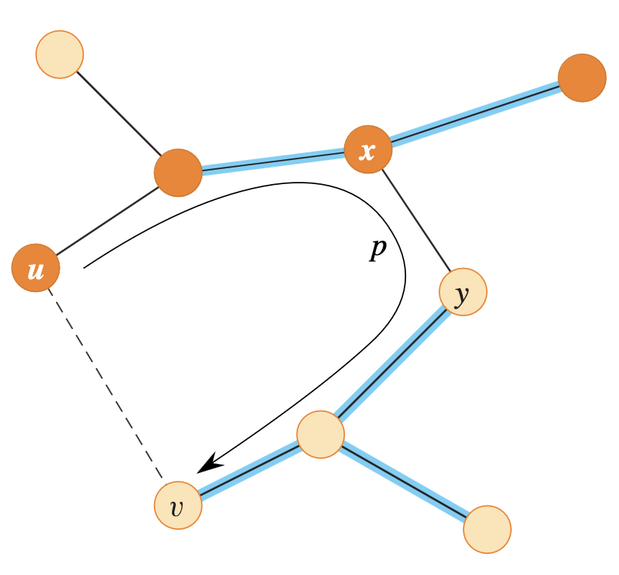

Proof in short
For any cut $(S, V−S)$ , we always requires one edge to connect the two partitions to form a spanning tree
We can try exchanging any other edge for the light edge and the resulting weight can only increases or stay the same
CLRS has a more complete proof

Slide 19
Kruskal’s algorithm
Sort the edges in ascending order of weights
Make each vertex a set at initialization
Iterate over all the edges
If the two endpoints are not in the same set (they haven’t been connected), add the edge to the tree and merge the sets of the endpoints (connected them)
If the two endpoints have already in the same set, skip the edge

Slide 20
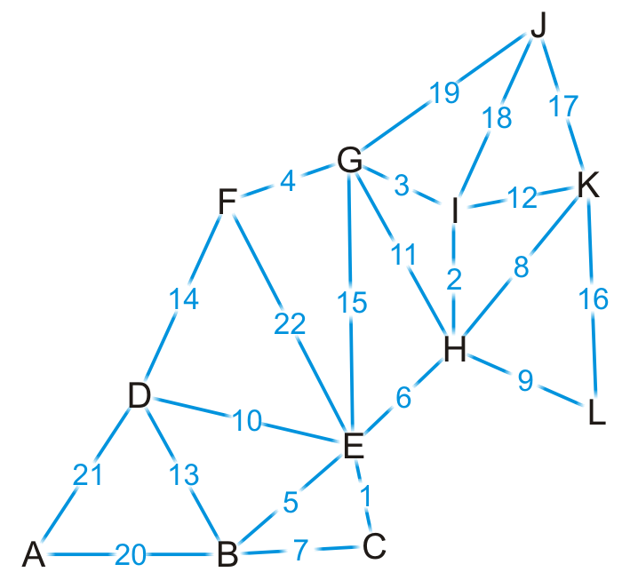
Example
Let us give a weight to each of the edges

Slide 21
Example
{C, E}
{H, I}
{G, I}
{F, G}
{B, E}
{E, H}
{B, C}
{H, K}
{H, L}
{D, E}
{G, H}
{I, K}
{B, D}
{D, F}
{E, G}
{K, L}
{J, K}
{J, I}
{J, G}
{A, B}
{A, D}
{E, F}
First, we sort the edges based on weight

Slide 22

Example
{C, E}
{H, I}
{G, I}
{F, G}
{B, E}
{E, H}
{B, C}
{H, K}
{H, L}
{D, E}
{G, H}
{I, K}
{B, D}
{D, F}
{E, G}
{K, L}
{J, K}
{J, I}
{J, G}
{A, B}
{A, D}
{E, F}
We start by adding edge {C, E}

Slide 23
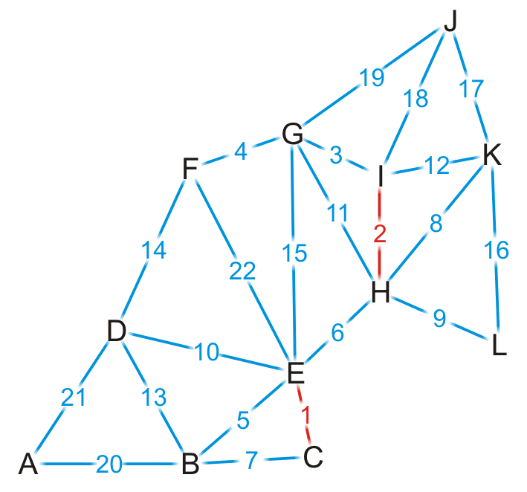
Example
{C, E}
{H, I}
{G, I}
{F, G}
{B, E}
{E, H}
{B, C}
{H, K}
{H, L}
{D, E}
{G, H}
{I, K}
{B, D}
{D, F}
{E, G}
{K, L}
{J, K}
{J, I}
{J, G}
{A, B}
{A, D}
{E, F}
We add edge {H, I}

Slide 24
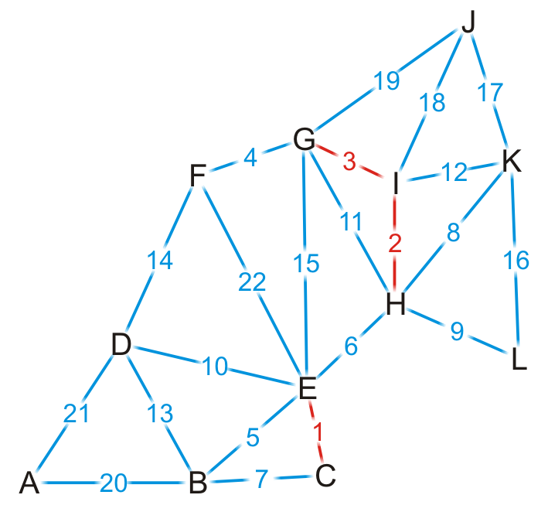
Example
{C, E}
{H, I}
{G, I}
{F, G}
{B, E}
{E, H}
{B, C}
{H, K}
{H, L}
{D, E}
{G, H}
{I, K}
{B, D}
{D, F}
{E, G}
{K, L}
{J, K}
{J, I}
{J, G}
{A, B}
{A, D}
{E, F}
We add edge {G, I}

Slide 25

Example
{C, E}
{H, I}
{G, I}
{F, G}
{B, E}
{E, H}
{B, C}
{H, K}
{H, L}
{D, E}
{G, H}
{I, K}
{B, D}
{D, F}
{E, G}
{K, L}
{J, K}
{J, I}
{J, G}
{A, B}
{A, D}
{E, F}
We add edge {F, G}

Slide 26
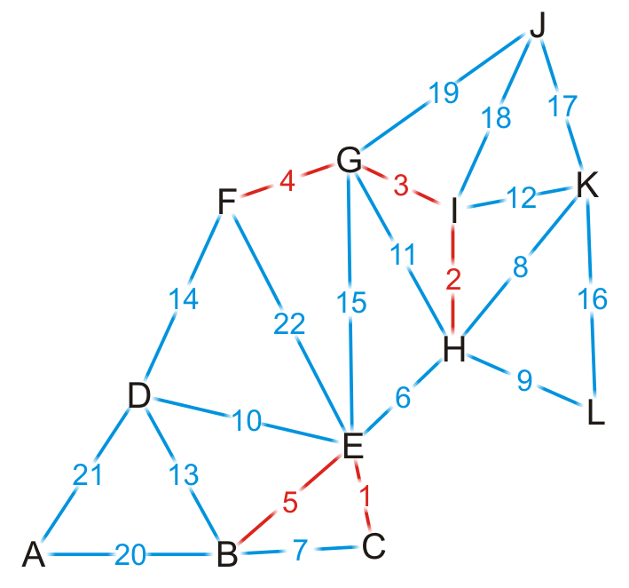
Example
{C, E}
{H, I}
{G, I}
{F, G}
{B, E}
{E, H}
{B, C}
{H, K}
{H, L}
{D, E}
{G, H}
{I, K}
{B, D}
{D, F}
{E, G}
{K, L}
{J, K}
{J, I}
{J, G}
{A, B}
{A, D}
{E, F}
We add edge {B, E}

Slide 27
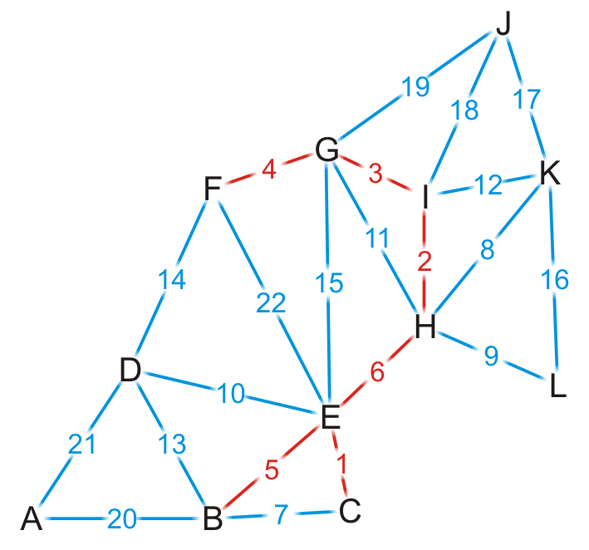
Example
{C, E}
{H, I}
{G, I}
{F, G}
{B, E}
{E, H}
{B, C}
{H, K}
{H, L}
{D, E}
{G, H}
{I, K}
{B, D}
{D, F}
{E, G}
{K, L}
{J, K}
{J, I}
{J, G}
{A, B}
{A, D}
{E, F}
We add edge {E, H}
This coalesces the two spanning sub-trees into one

Slide 28
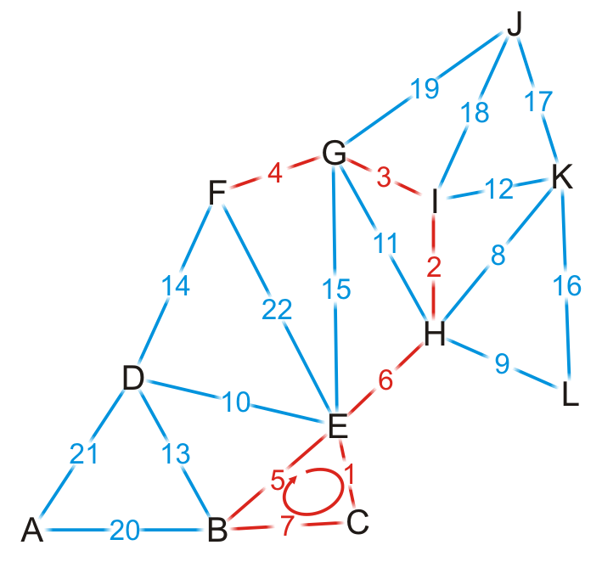
Example
{C, E}
{H, I}
{G, I}
{F, G}
{B, E}
{E, H}
{B, C}
{H, K}
{H, L}
{D, E}
{G, H}
{I, K}
{B, D}
{D, F}
{E, G}
{K, L}
{J, K}
{J, I}
{J, G}
{A, B}
{A, D}
{E, F}
We try adding {B, C}, but it creates a cycle

Slide 29
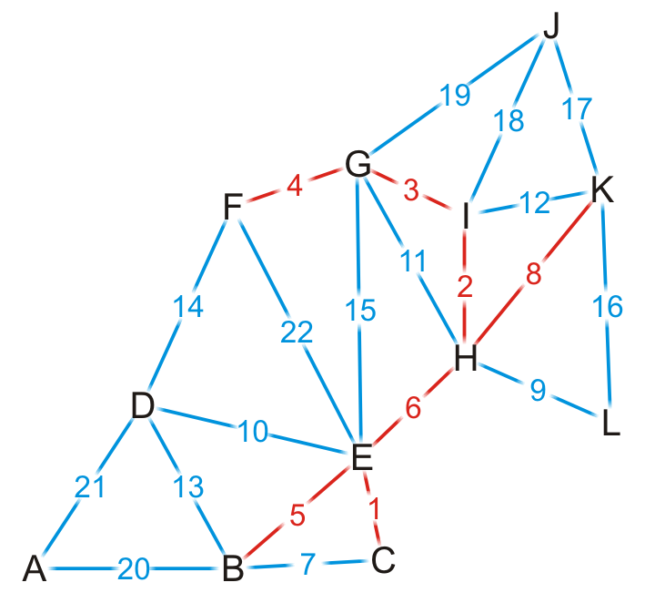
Example
{C, E}
{H, I}
{G, I}
{F, G}
{B, E}
{E, H}
{B, C}
{H, K}
{H, L}
{D, E}
{G, H}
{I, K}
{B, D}
{D, F}
{E, G}
{K, L}
{J, K}
{J, I}
{J, G}
{A, B}
{A, D}
{E, F}
We add edge {H, K}

Slide 30
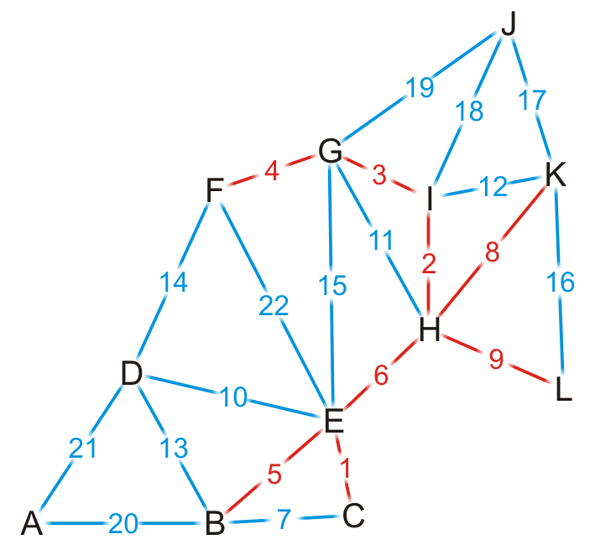
Example
{C, E}
{H, I}
{G, I}
{F, G}
{B, E}
{E, H}
{B, C}
{H, K}
{H, L}
{D, E}
{G, H}
{I, K}
{B, D}
{D, F}
{E, G}
{K, L}
{J, K}
{J, I}
{J, G}
{A, B}
{A, D}
{E, F}
We add edge {H, L}

Slide 31
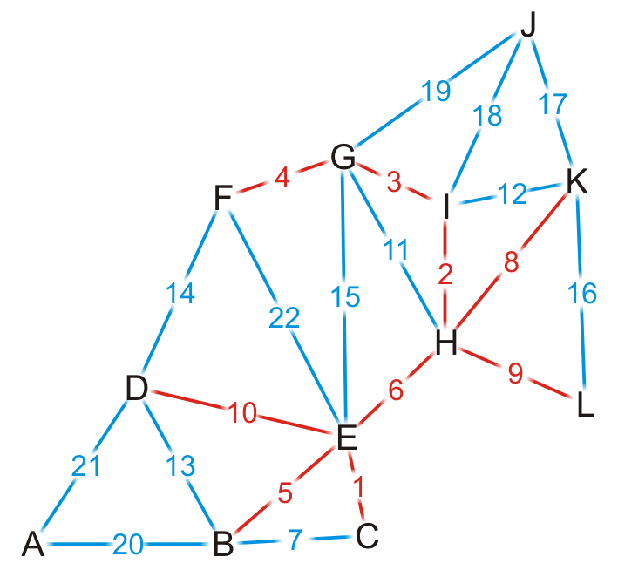
Example
{C, E}
{H, I}
{G, I}
{F, G}
{B, E}
{E, H}
{B, C}
{H, K}
{H, L}
{D, E}
{G, H}
{I, K}
{B, D}
{D, F}
{E, G}
{K, L}
{J, K}
{J, I}
{J, G}
{A, B}
{A, D}
{E, F}
We add edge {D, E}

Slide 32
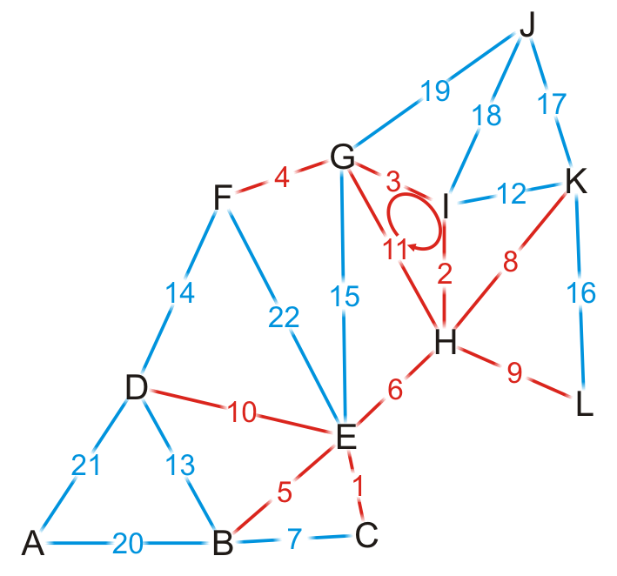
Example
{C, E}
{H, I}
{G, I}
{F, G}
{B, E}
{E, H}
{B, C}
{H, K}
{H, L}
{D, E}
{G, H}
{I, K}
{B, D}
{D, F}
{E, G}
{K, L}
{J, K}
{J, I}
{J, G}
{A, B}
{A, D}
{E, F}
We try adding {G, H}, but it creates a cycle

Slide 33
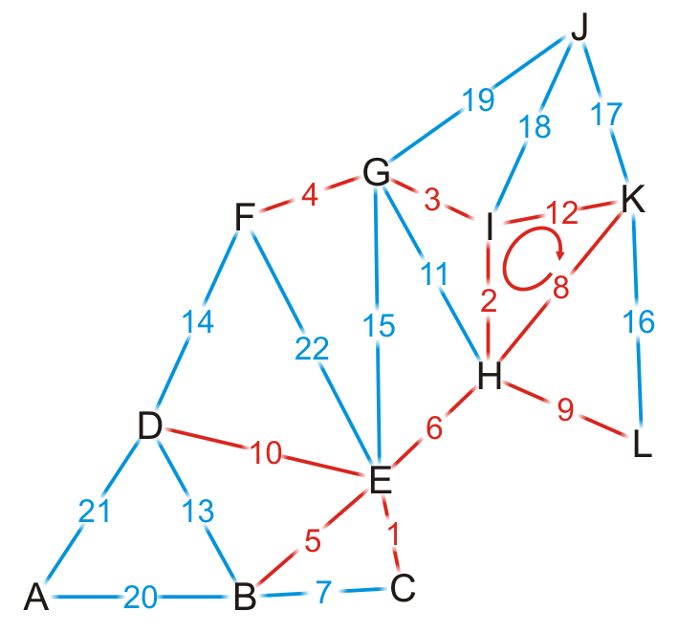
Example
{C, E}
{H, I}
{G, I}
{F, G}
{B, E}
{E, H}
{B, C}
{H, K}
{H, L}
{D, E}
{G, H}
{I, K}
{B, D}
{D, F}
{E, G}
{K, L}
{J, K}
{J, I}
{J, G}
{A, B}
{A, D}
{E, F}
We try adding {I, K}, but it creates a cycle

Slide 34
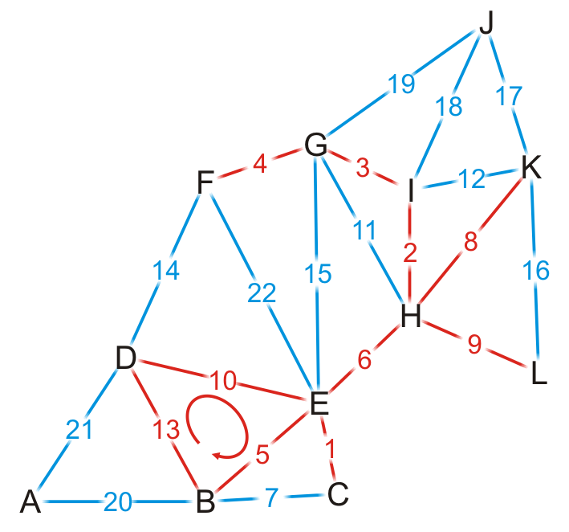
Example
{C, E}
{H, I}
{G, I}
{F, G}
{B, E}
{E, H}
{B, C}
{H, K}
{H, L}
{D, E}
{G, H}
{I, K}
{B, D}
{D, F}
{E, G}
{K, L}
{J, K}
{J, I}
{J, G}
{A, B}
{A, D}
{E, F}
We try adding {B, D}, but it creates a cycle

Slide 35
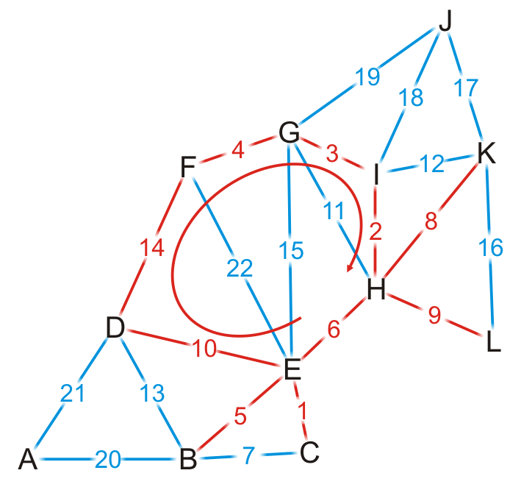
Example
{C, E}
{H, I}
{G, I}
{F, G}
{B, E}
{E, H}
{B, C}
{H, K}
{H, L}
{D, E}
{G, H}
{I, K}
{B, D}
{D, F}
{E, G}
{K, L}
{J, K}
{J, I}
{J, G}
{A, B}
{A, D}
{E, F}
We try adding {D, F}, but it creates a cycle

Slide 36
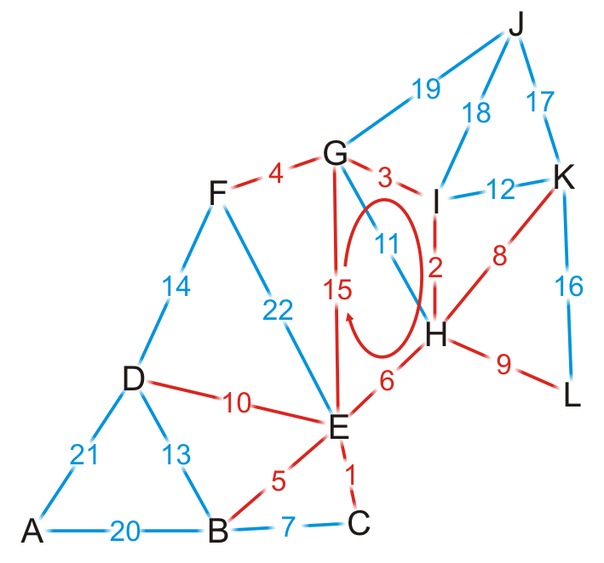
Example
{C, E}
{H, I}
{G, I}
{F, G}
{B, E}
{E, H}
{B, C}
{H, K}
{H, L}
{D, E}
{G, H}
{I, K}
{B, D}
{D, F}
{E, G}
{K, L}
{J, K}
{J, I}
{J, G}
{A, B}
{A, D}
{E, F}
We try adding {E, G}, but it creates a cycle

Slide 37
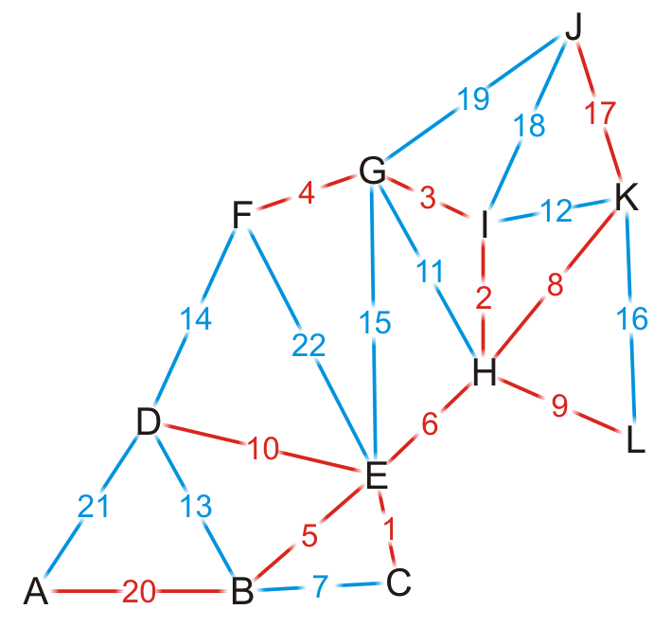
Example
{C, E}
{H, I}
{G, I}
{F, G}
{B, E}
{E, H}
{B, C}
{H, K}
{H, L}
{D, E}
{G, H}
{I, K}
{B, D}
{D, F}
{E, G}
{K, L}
{J, K}
{J, I}
{J, G}
{A, B}
{A, D}
{E, F}
By observation, we can still add edges {J, K} and {A, B}

Slide 38
Example
{C, E}
{H, I}
{G, I}
{F, G}
{B, E}
{E, H}
{B, C}
{H, K}
{H, L}
{D, E}
{G, H}
{I, K}
{B, D}
{D, F}
{E, G}
{K, L}
{J, K}
{J, I}
{J, G}
{A, B}
{A, D}
{E, F}
Having added {A, B}, we now have 11 edges
We terminate the loop
We have our minimum spanning tree

Slide 39
Analysis
Implementation
We would store the edges and their weights in an array
We would sort the edges using either quicksort or some distribution sort
To determine if a cycle is created, we could perform a traversal
A run-time of Ο(|V|)
Consequently, the run-time would be Ο(|E| ln(|E|) + |E|·|V|)
However, |E| = O(|V|²), so ln(E) = O(ln(|V|²)) = O(2 ln(|V|)) = O(ln(|V|))
Consequently, the run-time would be Ο(|E| ln(|V|) + |E||V|) = Ο(|E|·|V|)
The critical operation is determining if two vertices are connected

Slide 40
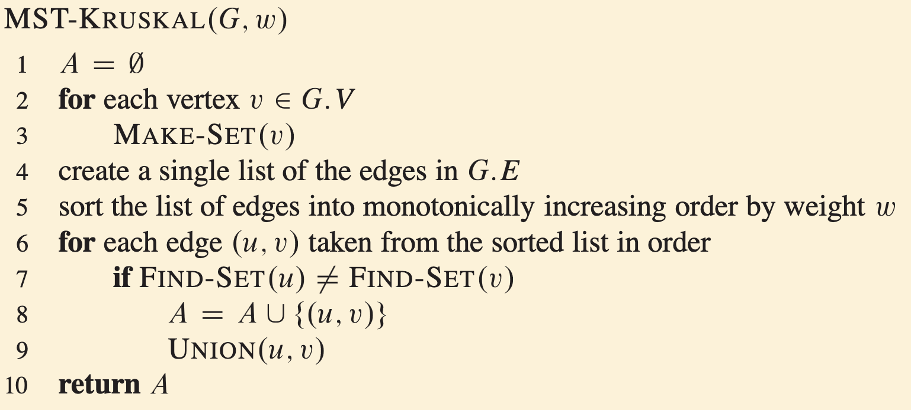
Disjoint-set implementation for Kruskal
The disjoint set data structure has the following average run-times:
Checking if two vertices are in the same set is Θ(α(|V|))
Taking the union of two disjoint sets is Θ(α(|V|))
For all possible sizes of |V|, α(|V|) = Θ(1)
Thus, checking and building the minimum spanning tree is now Ο(|E|)
The dominant time is now the time required to sort the edges:
Using quicksort, the run-time is Ο(|E| ln(|E|)) = Ο(|E| ln(|V|))

Slide 41
Prim’s algorithm
Prim’s algorithm for finding the minimum spanning tree states:
Start with an arbitrary vertex to form a minimum spanning tree on one vertex
At each step, add that vertex v not yet in the minimum spanning tree that has an edge with least weight that connects v to the existing minimum spanning sub-tree
Continue until we have n – 1 edges and n vertices

Slide 42
Prim’s Algorithm
Initialization:
Select a root node and set its distance as 0
Set the distance to all other vertices as ∞
Set all vertices to being unvisited
Set the parent pointer of all vertices to 0

Slide 43
Prim’s Algorithm
Iterate while there exists an unvisited vertex with distance < ∞
Select that unvisited vertex with minimum distance
Mark that vertex as having been visited
For each adjacent vertex, if the weight of the connecting edge is less than the current distance to that vertex:
Update the distance to equal the weight of the edge
Set the current vertex as the parent of the adjacent vertex

Slide 44
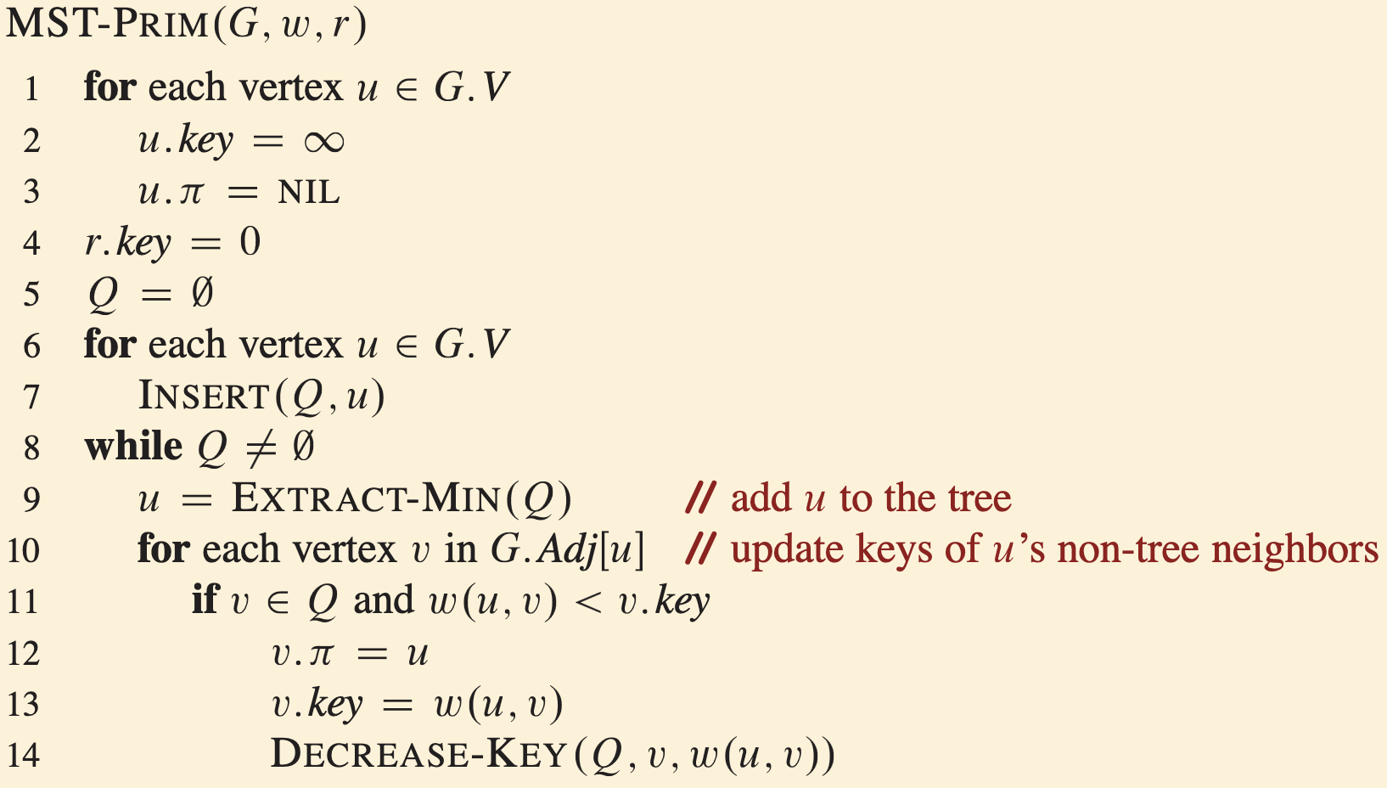
Prim’s algorithm

Slide 45
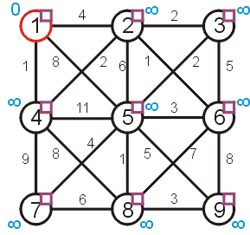
Prim’s Algorithm
Let us find the minimum spanning tree for the following undirected weighted graph

Slide 46
Prim’s Algorithm
First we set up the appropriate table and initialize it
 |  | Distance | Parent
1 | F | 0 | 0
2 | F | ∞ | 0
3 | F | ∞ | 0
4 | F | ∞ | 0
5 | F | ∞ | 0
6 | F | ∞ | 0
7 | F | ∞ | 0
8 | F | ∞ | 0
9 | F | ∞ | 0

Slide 47
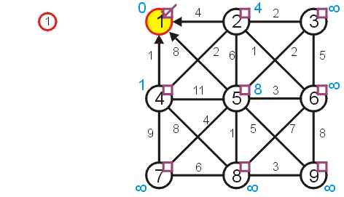
Prim’s Algorithm
Visiting vertex 1, we update vertices 2, 4, and 5
 |  | Distance | Parent
1 | T | 0 | 0
2 | F | 4 | 1
3 | F | ∞ | 0
4 | F | 1 | 1
5 | F | 8 | 1
6 | F | ∞ | 0
7 | F | ∞ | 0
8 | F | ∞ | 0
9 | F | ∞ | 0

Slide 48
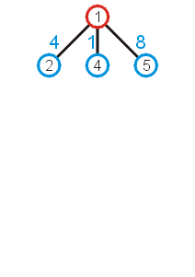
Prim’s Algorithm
What these numbers really mean is that at this point, we could extend the trivial tree containing just the root node by one of the three possible children:
As we wish to find a minimum spanning tree, it makes sense we add that vertex with a connecting edge with least weight

Slide 49
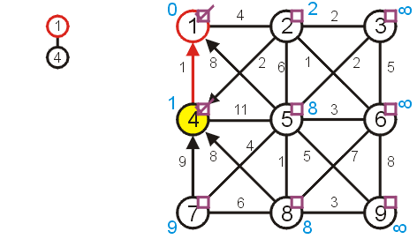
Prim’s Algorithm
The next unvisited vertex with minimum distance is vertex 4
Update vertices 2, 7, 8
Don’t update vertex 5
 |  | Distance | Parent
1 | T | 0 | 0
2 | F | 2 | 4
3 | F | ∞ | 0
4 | T | 1 | 1
5 | F | 8 | 1
6 | F | ∞ | 0
7 | F | 9 | 4
8 | F | 8 | 4
9 | F | ∞ | 0

Slide 50
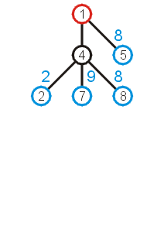
Prim’s Algorithm
Now that we have updated all vertices adjacent to vertex 4, we can extend the tree by adding one of the edges
(1, 5), (4, 2), (4, 7), or (4, 8)
We add that edge with the least weight: (4, 2)

Slide 51
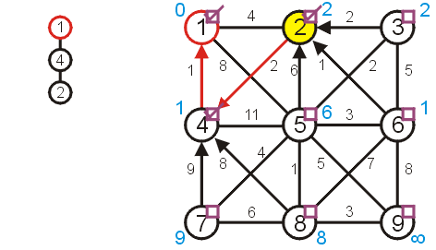
Prim’s Algorithm
Next visit vertex 2
Update 3, 5, and 6
 |  | Distance | Parent
1 | T | 0 | 0
2 | T | 2 | 4
3 | F | 2 | 2
4 | T | 1 | 1
5 | F | 6 | 2
6 | F | 1 | 2
7 | F | 9 | 4
8 | F | 8 | 4
9 | F | ∞ | 0

Slide 52
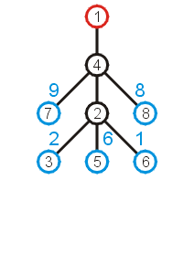
Prim’s Algorithm
Again looking at the shortest edges to each of the vertices adjacent to the current tree, we note that we can add (2, 6) with the least increase in weight

Slide 53
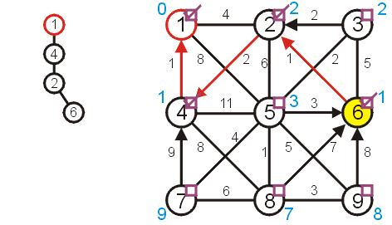
Prim’s Algorithm
Next, we visit vertex 6:
update vertices 5, 8, and 9
 |  | Distance | Parent
1 | T | 0 | 0
2 | T | 2 | 4
3 | F | 2 | 2
4 | T | 1 | 1
5 | F | 3 | 6
6 | T | 1 | 2
7 | F | 9 | 4
8 | F | 7 | 6
9 | F | 8 | 6

Slide 54
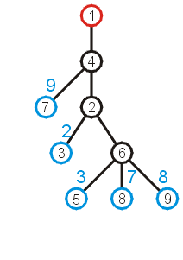
Prim’s Algorithm
The edge with least weight is (2, 3)
This adds the weight of 2 to the weight minimum spanning tree

Slide 55
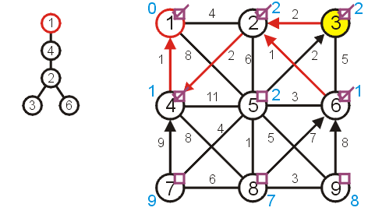
Prim’s Algorithm
Next, we visit vertex 3 and update 5
 |  | Distance | Parent
1 | T | 0 | 0
2 | T | 2 | 4
3 | T | 2 | 2
4 | T | 1 | 1
5 | F | 2 | 3
6 | T | 1 | 2
7 | F | 9 | 4
8 | F | 7 | 6
9 | F | 8 | 6

Slide 56
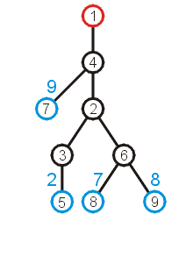
Prim’s Algorithm
At this point, we can extend the tree by adding the edge (3, 5)

Slide 57
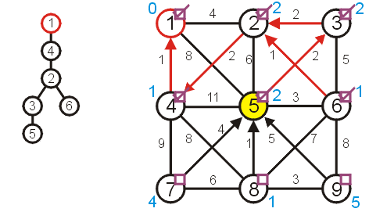
Prim’s Algorithm
Visiting vertex 5, we update 7, 8, 9
 |  | Distance | Parent
1 | T | 0 | 0
2 | T | 2 | 4
3 | T | 2 | 2
4 | T | 1 | 1
5 | T | 2 | 3
6 | T | 1 | 2
7 | F | 4 | 5
8 | F | 1 | 5
9 | F | 5 | 5

Slide 58
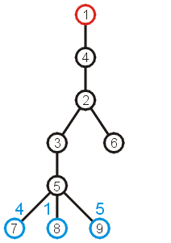
Prim’s Algorithm
At this point, there are three possible edges which we could include which will extend the tree
The edge to 8 has the least weight

Slide 59
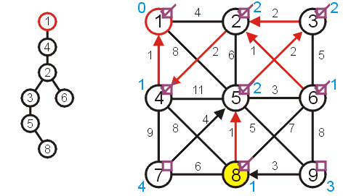
Prim’s Algorithm
Visiting vertex 8, we only update vertex 9
 |  | Distance | Parent
1 | T | 0 | 0
2 | T | 2 | 4
3 | T | 2 | 2
4 | T | 1 | 1
5 | T | 2 | 3
6 | T | 1 | 2
7 | F | 4 | 5
8 | T | 1 | 5
9 | F | 3 | 8

Slide 60
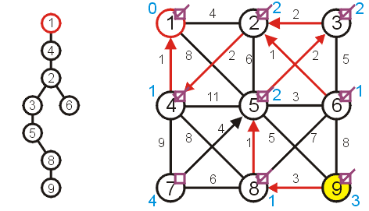
Prim’s Algorithm
There are no other vertices to update while visiting vertex 9
 |  | Distance | Parent
1 | T | 0 | 0
2 | T | 2 | 4
3 | T | 2 | 2
4 | T | 1 | 1
5 | T | 2 | 3
6 | T | 1 | 2
7 | F | 4 | 5
8 | T | 1 | 5
9 | T | 3 | 8

Slide 61
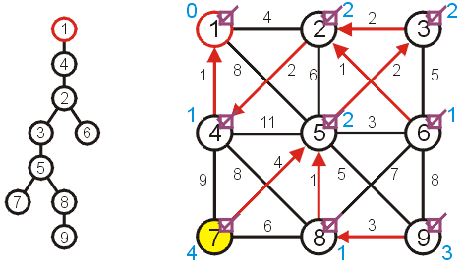
Prim’s Algorithm
And neither are there any vertices to update when visiting vertex 7
 |  | Distance | Parent
1 | T | 0 | 0
2 | T | 2 | 4
3 | T | 2 | 2
4 | T | 1 | 1
5 | T | 2 | 3
6 | T | 1 | 2
7 | T | 4 | 5
8 | T | 1 | 5
9 | T | 3 | 8

Slide 62
Prim’s Algorithm
At this point, there are no more unvisited vertices, and therefore we are done
If at any point, all remaining vertices had a distance of ∞, this would indicate that the graph is not connected
in this case, the minimum spanning tree would only span one connected sub-graph

Slide 63
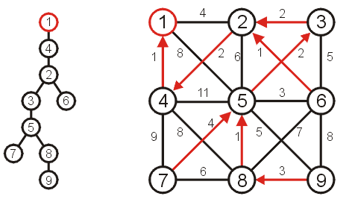
Prim’s Algorithm
Using the parent pointers, we can now construct the minimum spanning tree
 |  | Distance | Parent
1 | T | 0 | 0
2 | T | 2 | 4
3 | T | 2 | 2
4 | T | 1 | 1
5 | T | 2 | 3
6 | T | 1 | 2
7 | T | 4 | 5
8 | T | 1 | 5
9 | T | 3 | 8

Slide 64
Implementation and analysis
The initialization requires Θ(|V|) memory and run time
We iterate |V| – 1 times, each time finding the closest vertex
Iterating through the table requires is Θ(|V|) time
Each time we find a vertex, we must check all of its neighbors
With an adjacency matrix, the run time is Θ(|V|(|V| + |V|)) = Θ(|V|²)
With an adjacency list, the run time is Θ(|V|² + |E|) = Θ(|V|²) as |E| = O(|V|²)
Can we do better?
Recall, we only need the shortest edge next
How about a priority queue?Assume we are using a binary heap
We will have to update the heap structure—this requires additional work

Slide 65
Implementation and analysis
The initialization still requires Θ(|V|) memory and run time
The priority queue will also requires Ο(|V|) memory
We iterate |V| – 1 times, each time finding the closest vertex
Place the shortest distances into a priority queue
The size of the priority queue is Ο(|V|)
Thus, the work required for this is O(|V| ln(|V|))
Is this all the work that is necessary?
Recall that each edge visited may result in a new edge being pushed to the very top of the heap
Thus, the work required for this is O(|E| ln(|V|))
Thus, the total run time is O(|V| ln(|V|) + |E| ln(|V|)) = O(|E| ln(|V|))

Slide 66
Implementation and analysis
We could use a different heap structure:
A Fibonacci heap is a node-based heap
Pop is still O(ln(|V|)), but inserting and moving a key is Θ(1)
Thus, because we are only calling pop |V| – 1 times, work required reduces to O(|E| + |V| ln(|V|))
Thus, the overall run-time is O(|E| + |V| ln(|V|))

